Slide 1
Hotel Booking Cancellation Prediction
Building a predictive model that can predict which booking is going to be canceled in advance

Slide 2
Business Problem
A significant number of hotel bookings are called off due to cancellations or no-shows. The typical reasons for cancellations include changes of plans, scheduling conflicts, etc. This is often made easier by the option to do so free of charge or preferably at a low cost which is beneficial to hotel guests but it is a less desirable and possibly revenue-diminishing factor for hotels to deal with. The aim is to build a predictive model that can predict which booking is going to be canceled in advance.

Slide 3
Data Science Problem
The increasing number of cancellations calls for a Machine Learning based solution that can help in predicting which booking is likely to be canceled. INN Hotels Group has a chain of hotels in Portugal, they are facing problems with the high number of booking cancellations and have reached out to your firm for data-driven solutions. We have to analyze the data to find which factors have a high influence on booking cancellations, build a predictive model that can predict which booking is going to be canceled in advance, and help in formulating profitable policies for cancellations and refunds.

Slide 4
Dataset
The data contains the different attributes of customers' booking details. The target variable is booking_status which is a Flag indicating if the booking was canceled or not. The class 0 represents the Not_Canceled whereas class 1 represents the Canceled label.

Slide 5
EDA
The number of adults booking the hotel ranges from 0 to 4, which is usual. At least 75% of bookings have 2 adults.
Majority of the bookings have no children. This indicates that the most of the bookings might be from single people or young couples. The maximum value in the number of children column is 10, which is a bit unusual and might be an outlier.
The maximum values for the number of weeks and weekend nights are 7 weekends or 17 nights. These might be very long stays. We can explore these values further.
At least 75% of the customers do not require a car parking space. This indicates that the majority of the customers are traveling by personal vehicles.
On average, the customers book 85 days in advance. There's also a very huge difference in 75th percentile and the maximum value which indicates that there might be outliers present in this column.
The arrival year shows that we have the data from two years - 2017 and 2018.
At least 75% of the customers are not repeating customers.
At least 75% of bookings have no previous cancellations. The number of previous cancellations has a maximum value of 13.

Slide 6
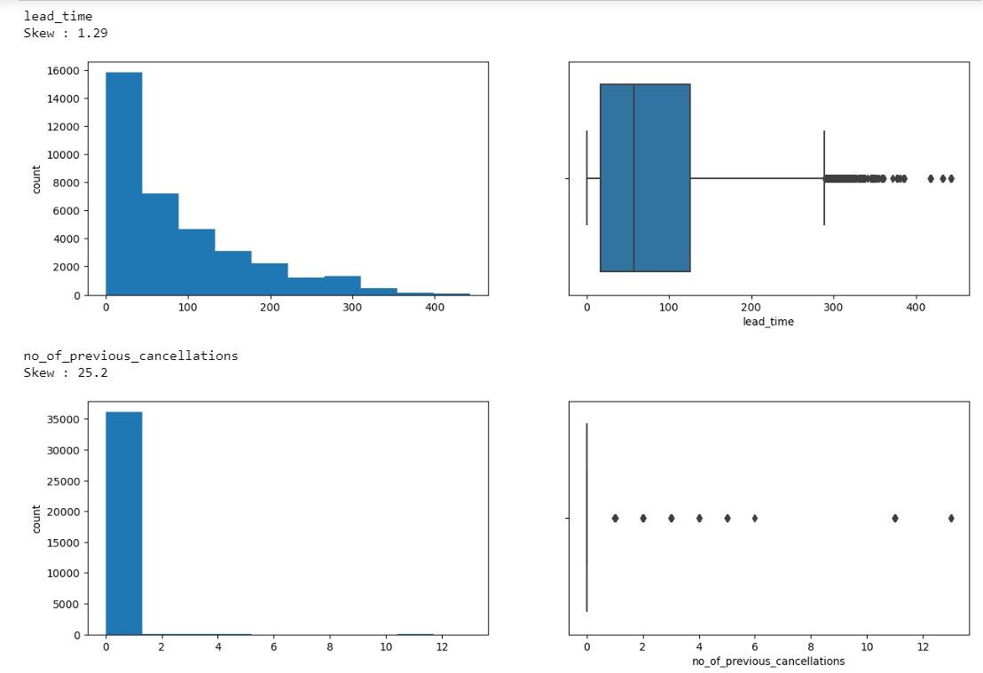
Cont.
The distribution of lead time is right-skewed implies the majority of customer make bookings close to the arrival date. Many customers have made the booking on the same day of arrival as well. There are many outliers, some customers made booking more than 400 days in advance.
Very few customers have more than one cancellation. Some customers canceled more than 12 times.

Slide 7
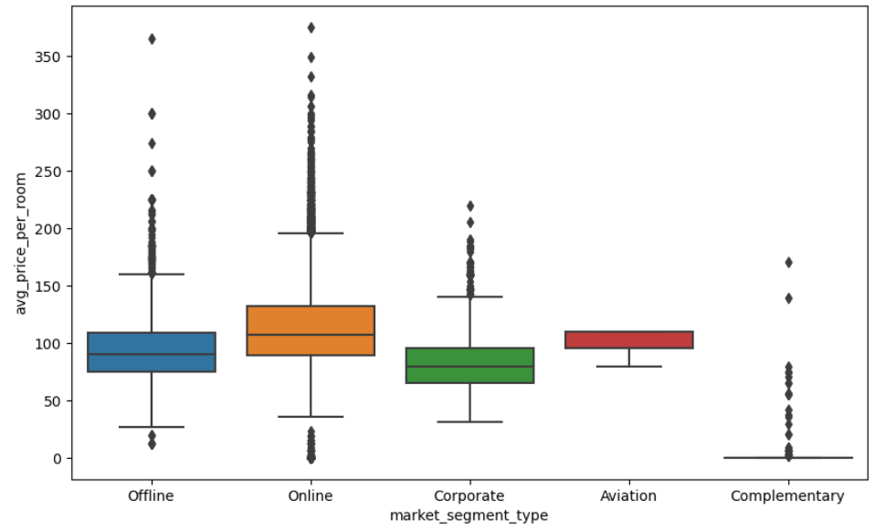
Cont.
Rooms booked online have the highest variations in prices.
The distribution for offline and corporate room prices are almost similar except for some outliers.
Complementary market segment gets the rooms at very low prices, which makes sense.

Slide 8
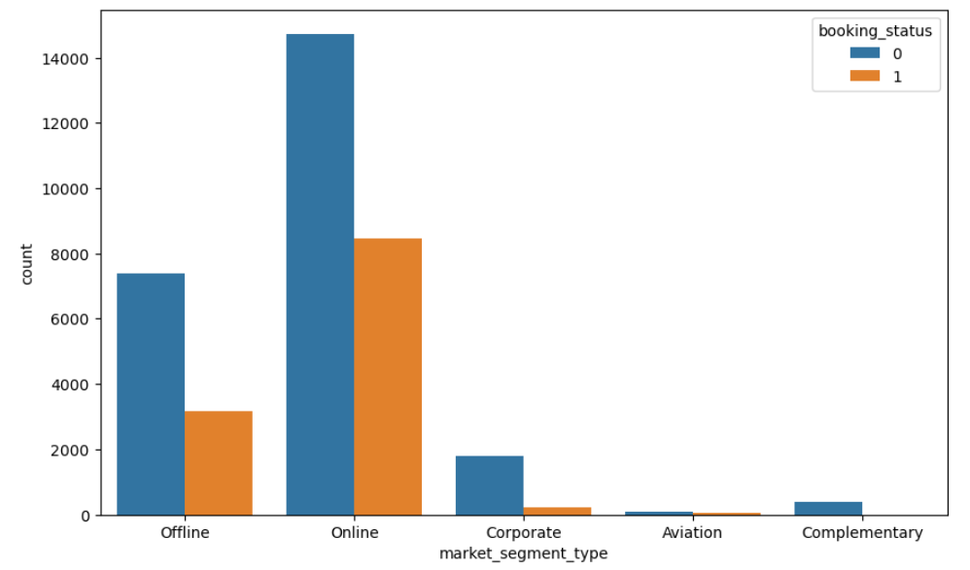
Cont.
Online bookings have the highest number of cancellations.
Bookings made offline are less prone to cancellations.
Corporate and complementary segment also show a very low number of cancellations.

Slide 9
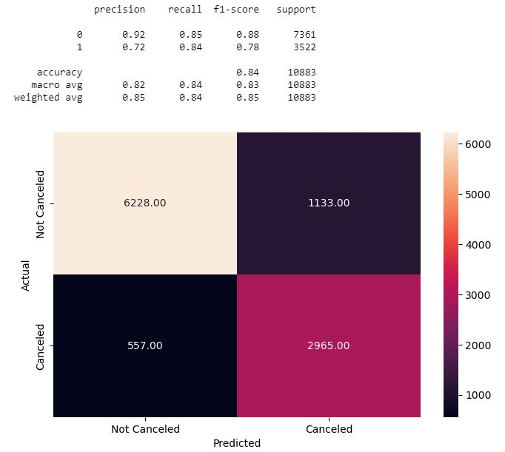
Models
Building a Decision Tree Model
The model has been evaluated on the test data and shown below:

Slide 10
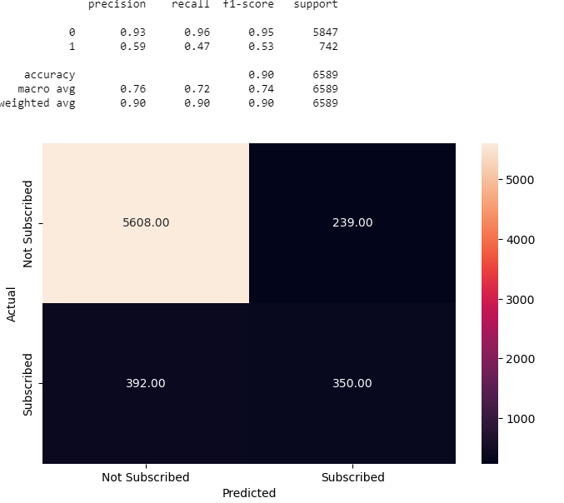
Cont.
Building a Random Forest Classifier
The model has been evaluated on the test data and shown below:

Slide 11
Conclusion & Feature work
We have been able to build tree-based models that can be used by the hotel to predict which bookings are likely to be canceled and know the important marketing policies accordingly.
The random forest model is giving the highest F1 score of 85% and the macro average of 89% on the test data.
Looking at important variables, based on the feature importances, we can say that the lead_time, no_of_special_requests, market_segment_type_Online, and avg_price_per_room, are the major drivers of the model.
The Decision tree model is highly overfitting the training data and gives an F1 score of 81% on the test data. The tuned Decision Tree model is very balanced and gives more generalized results on both training and testing data.
Using the tuned random forest model which has a 78% F1 score with balanced precision and recall scores, the hotel will be able to predict which bookings will be and will not be canceled. The hotel will be able to maintain a balance between resources and brand equity.
The future studies must improve the accuracy and compare different algorithms. The model should be trained on large dataset for better generality of results.

